Slide 1
City of Jacksonville, Florida
Disparity Study Overview:
Then and Now
October 23, 2020

Slide 2
Mason Tillman Associates, Ltd.
Established in 1978, Oakland based
Public policy research and marketing professionals
Award Winning Company
Equity service divisions
Business affirmative action
Corporate communications

Slide 3
Distinguishing Qualifications
Constitutionally sound and court-tested methodology
Performed 146 disparity studies since 1990
Fifteen disparity studies completed in State of Florida
Extensive M/WBE program design experience
Culturally sensitive community engagement professionals
Multiethnic and multilingual team
Experienced, trusted, and credible local consultants

Slide 4
Mason Tillman’s City Client List
City of Arlington, Texas | City of Kansas City, Missouri
City of Berkeley, California | City of Knoxville, Tennessee
City of Boston, Massachusetts | City of New Haven, Connecticut
City of Bridgeport, Connecticut | City of New York, New York
City of Cincinnati, Ohio | City of Oakland, California
City of Cleveland, Ohio | City of Pittsburgh, Pennsylvania
City of Columbus, Ohio | City of Portland, Oregon
City of Dallas, Texas | City of Richmond, California
City of Davenport, Iowa | City of San Jose, California
City of Durham, North Carolina | City of Seattle, Washington
City of Fort Wayne, Indiana | City of St. Louis, Missouri
City of Fort Worth, Texas | City of St. Petersburg, Florida
City of Gresham, Oregon | City of Tampa, Florida
City of Houston, Texas | City of Vicksburg, Mississippi
City of Indianapolis, Indiana | City of West Palm Beach, Florida
City of Jacksonville, Florida
Notes:
City of Berkeley -
Mason Tillman has lead race and equity projects for two cities that are comparable in size to Culver City: the City of Berkeley and City of Oakland.The work involved evaluating each city’s employment practices, identifying disparities in how City staff hire, retain, and promote their staff, and making recommendations to the cities on how to implement more equitable hiring and retention practices. Both projects were successfully completed, well received by the municipalities, and both cities implemented newstrategies as a result of Mason Tillman’swork.While not a city engagement, Mason Tillman workedwith the state of New Yorkto identify and address equity issues in itspracticesandproceduresandlaunchedan extensive outreach programto engage local community membersin the project. Mason Tillman planned and hosted16 community meetings inall five boroughs and other cities throughout thestate. Mason Tillman coordinated all outreach, planned and facilitated meetings, and collectedand analyzeddata. Each of the meetingswere well attended,and Mason Tillman drafted a Community Meeting Report for each one.

Slide 5
Mason Tillman’s Workforce Diversity
Ethnicity | Percent Male | Percent Female
African American | 15% | 25%
Asian American | 15% | 15%
Hispanic American | 5% | 5%
Caucasian | 5% | 15%

Slide 6
City of Jacksonville Disparity Study Findings 2005-2010

Slide 7
Prime Contracts Analyzed
Industry | Total Number of Contracts | Total Dollars Expended
Construction | 350 | $583,653,072
Architecture and Engineering | 67 | $128,615,128
Professional Services | 17 | $14,539,857
Goods and Other Services | 533 | $293,284,242
Total | 967 | $1,020,092,299

Slide 8
Subcontracts Analyzed
Industry | Total Number of Contracts | Total Dollars Expended
Construction | 514 | $99,580,233
Architecture and Engineering | 117 | $15,877,708
Total | 631 | $115,457,941

Slide 9
Contracts Analyzed
Informal and formal construction prime contracts
Informal and formal architecture and engineering prime contracts
Informal and formal goods and services prime contracts
∞∞
Construction subcontracts
Architecture and engineering subcontracts

Slide 10
Construction Prime Contract Disparity Findings
Informal contracts $200,000 and under no disparity found for any group
Formal contracts under $500,000 no disparity found for any group

Slide 11
Professional Service Prime Contract Disparity Findings
Too few contracts to analyze

Slide 12
Goods and Other Services Prime Contract Disparity Findings
Ethnicity/Gender | Goods and Other Services
Construction | Contracts Under $500,000 | Contracts $50,000 and Under
African Americans | Disparity | Disparity
Asian Americans | Disparity | No Disparity
Hispanic Americans | Disparity | No Disparity
Native Americans | No Disparity | No Disparity
Minority Business Enterprises | No Disparity | Disparity
Women Business Enterprises | No Disparity | No Disparity
Minority and Women Business Enterprises | No Disparity | Disparity

Slide 13
Subcontract Disparity Findings
Ethnicity/Gender | Construction | Architecture and Engineering
African Americans | Disparity | No Disparity
Asian Americans | No Disparity | Disparity
Hispanic Americans | Disparity | No Disparity
Native Americans | No Disparity | No Disparity
Minority Business Enterprises | Disparity | No Disparity
Women Business Enterprises | No Disparity | Disparity
Minority and Women Business Enterprises | No Disparity | No Disparity

Slide 14
Anecdotal Findings
Racial barriers and harassment
Higher standards of review for MBEs
Prequalification requirements exclusionary
Bid shopping and inadequate lead time to respond to solicitations
Difficulty negotiating competitive supplier agreements
Barriers to bonding
Prime contractors’ late payments to MWBEs
MBE certification process challenging
Front companies being used to meet MBE goals
Barriers to operating capital

Slide 15
Program Recommendations

Slide 16
Race and Gender-Conscious Remedies

Slide 17
Prime Contract Remedies
Track and monitor comprehensive prime contract awards and payments in order to conduct an ongoing analysis of expenditures by ethnicity, gender, and industry
Employ a Small Contracts Rotation Program for goods and other services at the informal level in order to ensure that quotations for contracts are solicited from a diverse pool of certified and prequalified M/WBEs on a rotating basis.

Slide 18
Subcontract Remedies
Subcontract Remedies
Set overall subcontracting goal to remedy the documented disparity in architecture and engineering where there was a finding of statistically significant underutilization.
Set contract-specific subcontracting goal on all architecture and engineering prime contracts over $100,000 for each ethnic and gender group that had statistically significant underutilization.
Conduct subcontracting goal attainment reviews for all prime bid submittals prior to the recommendation for award to ascertain whether or not the bidder has met the M/WBE subcontracting goal(s).
Implement quantified Good Faith Effort Criteria in order to objectively assess the bidders Good Faith Effort statement.

Slide 19
Race and Gender-Neutral Recommendations

Slide 20
JSEB Program Enhancements
Review size standards and tailor them to correspond with the sizes of its businesses. The size profile of the COJ’s businesses can be derived from the business license data.
Create a Very Small Business Enterprise category with eligibility criteria that would limit competition to Very Small Business Enterprise. It is recommended that the Very Small Business Enterprise size should be limited to companies with three-year average gross sales of $750,000 or less.
Penalties for not achieving the project goal to address a prime contractor’s failure to meet the goal at the end of its contracts. The option of imposing penalties should be included in the Program.
Unbundle Large Procurements into Smaller Contracts to prevent small firms from bidding on the parts for which they are qualified. Unbundling will bring more opportunities within reach of the majority of the local businesses.
Amend current certification requirements for Race Conscious Program so that applicants requesting MBE certification must provide proof of minority status.

Slide 21
Recommended Procurement Strategies
Pre-bid recommendation
Networking Opportunities
Use Direct Contracting to Award Small Prime Contracts
Establish a Direct Purchase Program for Construction Contracts
Revise Insurance Requirements
Phase Retainage Requirements
Maintain Virtual Plan Room

Slide 22
Recommended Procurement Strategies (cont.)
Post-award recommendations
Pay mobilization to subcontractors
Give five-day notice of invoice disputes
Implement formal dispute resolution standards
Implement a commercially useful function requirement
Provide debriefing sessions for unsuccessful bidders
Institute a payment verification program
Conduct routine post-award contract compliance monitoring

Slide 23
Recommended Procurement Strategies (cont.)
Additional administrative recommendations
Develop a JSEB Program Manual and Training Program to standardize the delivery of the JSEB Program requirements. A manual could ensure that all department managers and their staff have the knowledge and skills to fulfill their duties within the Program.
Fully staff the JSEB Office to implement and enhance the JSEB Program. The staff should have knowledge about procurement standards, Florida contracting law, regulations, and affirmative action programs.

Slide 24
Tracking and Monitoring Systems Assessment and Recommendations
Purpose:
To enhance COJ’s management of the financial and procurement data necessary to ensure accuracy of its utilization reports.
Use a unique identifier for all contracts regardless of procurement type in order to eliminate duplicate contract numbers.

Slide 25
Disparity Study Legal Standard

Slide 26
City of Richmond v. J.A. Croson
State/Local
Federal
Adarand v. Pena
Richmond v. Croson
Compelling interest
Evidence of systemic racial discrimination
Narrowly tailored
Remedy documented discrimination
Update periodically
Assess effectiveness of remedy

Slide 27
City of Richmond v. J.A. Croson
The Facts:
14th Amendment equal protection challenge to City of Richmond, VA MBE contracting program
City adopted a Minority Business Utilization Plan
30% subcontracting set aside for Minority Business Enterprises

Slide 28
Narrowly Tailored Remedies
Disparity findings are ethnic and gender-specific
Race and gender goals are limited to disparity findings
Goals defined by availability

Slide 29
Legally Defensible Disparity Study Methodology

Slide 30
Utilization
The total contracts and actual dollars awarded during the study period
Prime contracts
Subcontracts
Geographic market area is defined by where most dollars are spent

Slide 31
Contract Utilization Elements
Prime Contract Award
Contract Number and Award Date
Contract Industry Code
Prime Ethnicity and Gender
Prime Task Orders
Prime Amendment and Change Orders
Subcontract Award
Subcontractor Ethnicity and Gender
Subcontract Payments

Slide 32
Data Cleaning Challenges
Prime contracts
Identify task/work orders issued on master agreements, on-call, price agreements
Identify design-build, indefinite delivery, CM @-risk contracts
Clean data to exclude nonprofits, government agencies, residents
Identify and code contractor industry/ethnicity/gender
Resolve payment and award discrepancies
Subcontracts
Identify subcontractors on design-bid-build contracts, design-build, CM @-risk, master agreements, On-call prime contracts
Verify utilization and payment
Code ethnicity/gender
Reconstruct missing data

Slide 33
Availability
The count of willing and able businesses in the market area
Businesses identified from government sources are willing and able
Businesses identified from non-government sources are surveyed for:
Business age, revenue, industry, number of employees
Business owner race, gender, education, experience
Business capability as number of contracts, bidding history
The percent of available businesses is calculated by ethnic and gender group to determine expected contract dollars

Slide 34
Business Profile Overview
Business Size by Employees | United States | State of Florida | Duval County | City of Jacksonville
Fewer than 5 Employees | 25.92% | 26.56% | 25.45% | 25.49%
Fewer than 10 Employees | 34.60% | 34.80% | 35.15% | 35.12%
Fewer than 20 Employees | 38.84% | 38.13% | 38.78% | 38.76%
More than 100 Employees | 0.64% | 0.51% | 0.61% | 0.63%
Minority-owned Business | 20.66% | 29.11% | 17.70% | 18.10%
Woman-owned Business | 44.17% | 39.80% | 42.67% | 42.67%
Source: InfoUSA, October 2020

Slide 35
Sources of Market-Area Businesses
Pool of Businesses
Certification Lists
Bidders Lists
Association/ Chamber Membership Lists
Business Advocacy Groups
Social Media Outreach
Business Community Meetings
Vendors Lists – may not be current
Business Licenses – are over-inclusive
Dun & Bradstreet – undercounts small, new, and M/WBEs
Mason Tillman does not rely on:

Slide 36
Determination of Willingness
Willingness affirmed for:
Utilized businesses
Certified businesses
Pre-qualified businesses
Bidders
Willingness must be confirmed for:
Trade association members
Chamber of commerce members

Slide 37
Determination of Ethnicity and Gender
Research methods
Determine if certified by government agency
Review company website for owner’s ethnicity and gender
Survey business to request owner’s ethnicity and gender
Search internet for business owner presence

Slide 38
Determination of Business Capacity
Analyze prime contracts by size
Profile largest contracts awarded by ethnicity and gender
Survey capacity of willing businesses
Assess business and owner characteristics
Business age, revenue, number of contracts awarded, industry, number of employees, bidding history
Business owner race, gender, education, experience
Ordered logistic regression analysis
Regression coefficient tables, 95% confidence level
Cumulative frequency summary
Chi-square test of independence, 95% confidence level
Updated Method

Slide 39
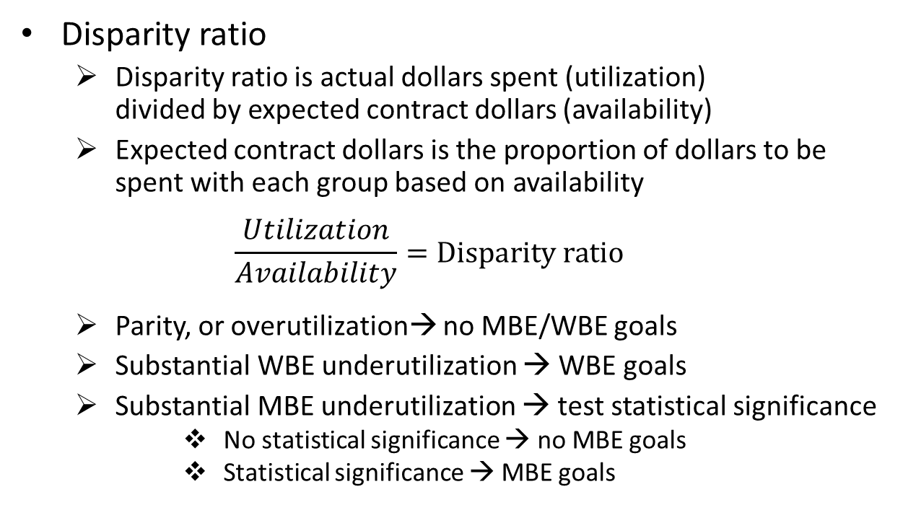
Statistical Tests of Disparity
Disparity ratio
Disparity ratio is actual dollars spent (utilization) divided by expected contract dollars (availability)
Expected contract dollars is the proportion of dollars to be spent with each group based on availability
$$\frac{Utilization}{Availability}=Disparity ratio$$
Parity, or overutilization→ no MBE/WBE goals
Substantial WBE underutilization → WBE goals
Substantial MBE underutilization → test statistical significance
No statistical significance → no MBE goals
Statistical significance → MBE goals

Slide 40
Anecdotal Analysis
Interviews conducted with MWBE business owners to collect perceptions of contracting with the City
Survey data collected from all available businesses on pre- and post-pandemic contracting experiences
Qualitative data analyzed for commonalities and patterns in the respondents’ experiences
Anecdotal evidence used to inform the race and gender-neutral recommendations
Impact of Covid-19 analyzed and quantified

Slide 41
Fee Structure
Study Components | Utilization Analysis | Disparity Analysis | Disparity Study
Fee | $75,000 | $150,000 | $350,000
Legal Analysis |  |  | x
Procurement Analysis |  |  | x
Prime Contractor Utilization Analysis | x | x | x
Subcontractor Utilization Analysis |  | x | x
Availability Analysis | x | x | x
Capacity Analysis |  |  | x
Prime Contract Disparity Analysis |  | x | x
Subcontract Disparity Analysis |  | x | x
Anecdotal Analysis |  |  | x
Race and Gender-Specific Recommendations |  | x | x
Race and Gender-Neutral Recommendations | x | x | x

Slide 42
Questions

Slide 43
Merci!
감사합니다!
cảm ơn!
धन्यवाद!
THANK YOU!
謝謝!
Grazie!
متشکرم
¡Gracias!
Cпасибо!
Dziękuję Ci
Obrigado!

